Slide 1
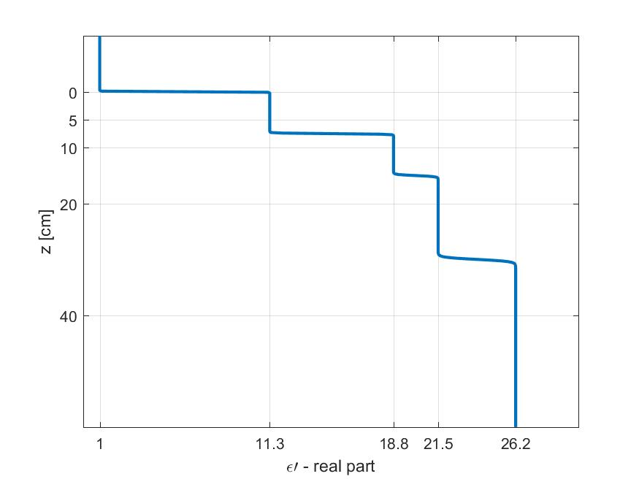
Discrete Dielectric Slab
Artificial Boundaries
Air
Soil Layer 1
VSM 21% @5cm
Soil Layer 2
VSM 34% @10cm
Soil Layer 3
VSM 38% @20cm
VSM 44% @40cm
Soil Layer 4

Slide 2


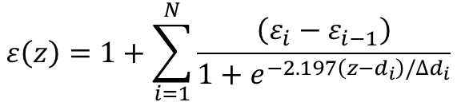

Continuous Dielectric Profile
Smoother Transitions
Air
Soil
VSM 21% @5cm
VSM 34% @10cm
VSM 38% @20cm
VSM 44% @40cm
Depth standard deviation
$$ε\left(z\right)=1+\sum_{i=1}^{N}{\frac{\left(ε_{i}−ε_{i−1}\right)}{1+e^{−2.197\left(z−d_{i}\right)/{∆d}_{i}}}}$$
$${∆d}_{i}=0.1×d_{i}$$
Sigmoid curve
Discretization Interval
$$∆z=1 mm$$

Slide 3
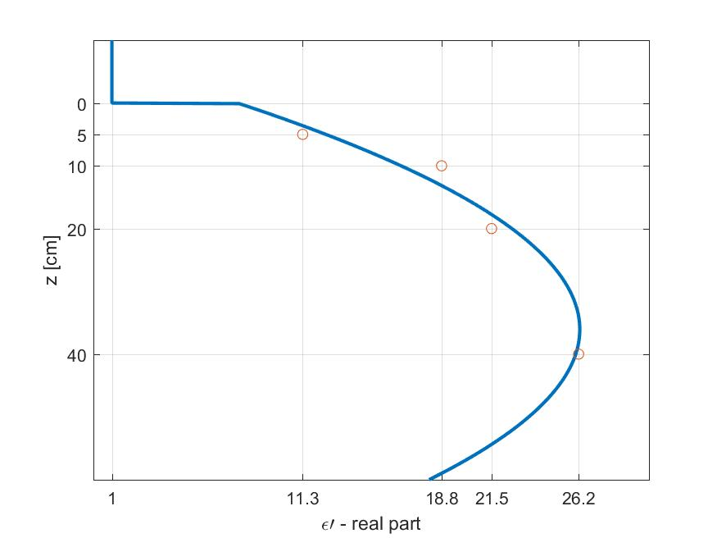
Continuous Dielectric Profile
2nd order polynomial fit
Air
Soil
VSM 21% @5cm
VSM 34% @10cm
VSM 38% @20cm
VSM 44% @40cm
Discretization Interval
$$∆z=1 mm$$

Slide 4
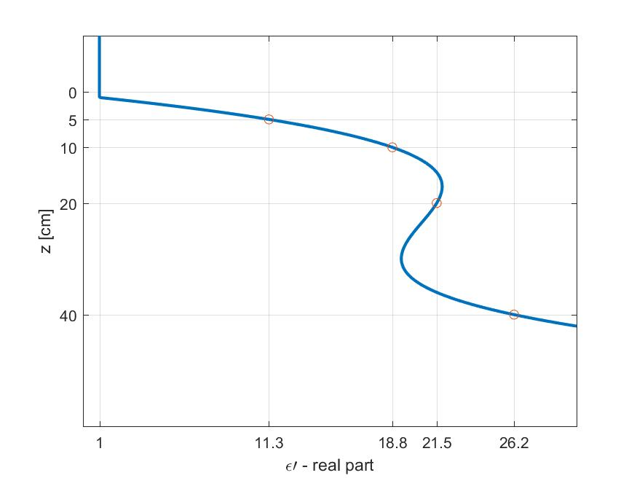
Continuous Dielectric Profile
3rd order polynomial fit
Air
Soil
VSM 21% @5cm
VSM 34% @10cm
VSM 38% @20cm
VSM 44% @40cm
Discretization Interval
$$∆z=1 mm$$

Slide 5
Measured Soil Moisture

